Slide 1
Legal Requirements
Registered Agents for Business Entities in Colorado

Slide 2
Colo. Rev. Stat. § 7-90-701:
(1) Every domestic entity for which a constituent filed document is on file in the records of the secretary of state and every foreign entity authorized to transact business or conduct activities in this state shall continuously maintain in this state a registered agent that shall be:
An individual who is eighteen years of age or older whose primary residence or usual place of business is in this state;
A domestic entity having a usual place of business in this state; or
A foreign entity authorized to transact business or conduct activities in this state that has a usual place of business in this state.
(2) An entity having a usual place of business in this state may serve as its own registered agent.
(3) Any document delivered to the secretary of state for filing on behalf of an entity that appoints a person as the registered agent for the entity shall contain a statement that the person has consented to being so appointed.

Slide 3
Colo. Rev. Stat. § 7-90-701:
(1) Every domestic entity for which a constituent filed document is on file in the records of the secretary of state and every foreign entity authorized to transact business or conduct activities in this state shall continuously maintain in this state a registered agent that shall be:
An individual who is eighteen years of age or older whose primary residence or usual place of business is in this state;
A domestic entity having a usual place of business in this state; or
A foreign entity authorized to transact business or conduct activities in this state that has a usual place of business in this state.
(2) An entity having a usual place of business in this state may serve as its own registered agent.
(3) Any document delivered to the secretary of state for filing on behalf of an entity that appoints a person as the registered agent for the entity shall contain a statement that the person has consented to being so appointed.

Slide 4
Colo. Rev. Stat. § 7-90-704:
(1) The registered agent of an entity is an agent of the entity authorized to receive service of any process, notice, or demand required or permitted by law to be served on the entity. The registered agent of an entity is an agent of the entity to whom the secretary of state may deliver any form, notice, or other document with respect to the entity under this title, unless otherwise specified by an organic statute.

Slide 5
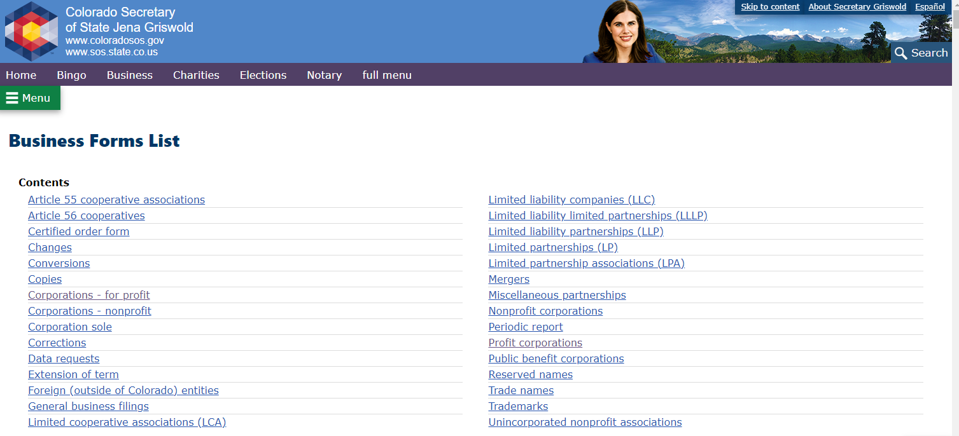
SoS Business Forms: https://www.coloradosos.gov/pubs/business/forms_main.html#Profit

Slide 6
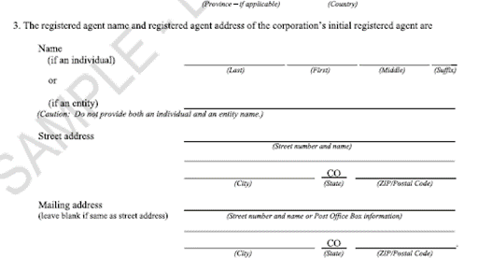
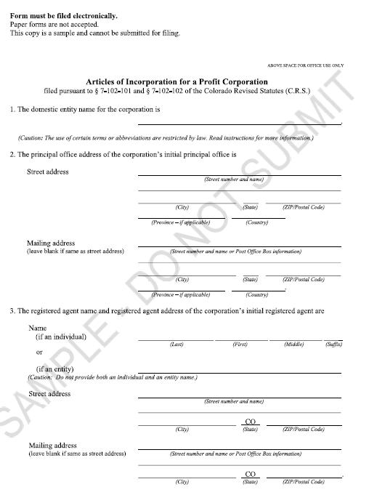
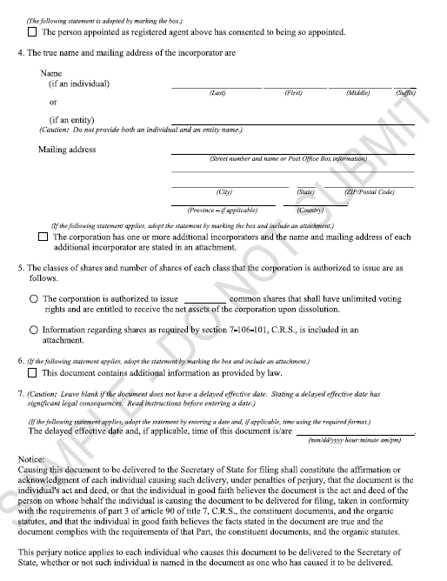
Sample Form: Articles of Incorporation

Slide 7
Potential Amendments of § 7-90-701:
Amendment A:
(1) Every domestic entity for which a constituent filed document is on file in the records of the secretary of state and every foreign entity authorized to transact business or conduct activities in this state shall continuously maintain in this state a registered agent that shall be:
An individual who is eighteen years of age or older whose primary residence or usual place of business is in this state;
A domestic entity in good standing as listed on the Secretary of State’s business registry having a usual place of business in this state; or
A foreign entity authorized to transact business or conduct activities in this state as listed on the Secretary of State’s business registry that has a usual place of business in this state.

Slide 8
Potential Amendments of § 7-90-701:
Amendment B:
(1) Every domestic entity for which a constituent filed document is on file in the records of the secretary of state and every foreign entity authorized to transact business or conduct activities in this state shall continuously maintain in this state a registered agent that shall be:
An individual who is eighteen years of age or older whose primary residence or usual place of business is in this state and who is registered to vote in Colorado as listed in the statewide voter registration system maintained by the Secretary of State;
A domestic entity in good standing as listed on the Secretary of State’s business registry having a usual place of business in this state; or
A foreign entity authorized to transact business or conduct activities in this state as listed on the Secretary of State’s business registry that has a usual place of business in this state.

Slide 9
Potential Amendments of § 7-90-701:
Amendment C:
(1) Every domestic entity for which a constituent filed document is on file in the records of the secretary of state and every foreign entity authorized to transact business or conduct activities in this state shall continuously maintain in this state a registered agent that shall be:
An individual who is eighteen years of age or older whose primary residence or usual place of business is in this state and who is registered to vote in Colorado as listed in the statewide voter registration system maintained by the Secretary of State;
A domestic entity in good standing as listed on the Secretary of State’s business registry having a usual place of business in this state; or
A foreign entity authorized to transact business or conduct activities in this state as listed on the Secretary of State’s business registry that has a usual place of business in this state.

