Slide 1
Let’s Talk about Colorado Shells
This presentation is from the viewpoint of a federal investigator who has investigated shell companies and has seen the devastation that they can do.
The viewpoints expressed in this presentation, and associated proposals, are the presenter’s and not his agency. This presentation was created to provide the Colorado Fraudulent Business Filings Working Group an additional perspective to consider when suggesting proposals to the State Legislature for legislative action.
Creator: Greg Wertsch

Slide 2
SheLL FORMATION

Slide 3
What is a shell company?
Shells are business entities without active business or significant assets.
They don't create products.
They don’t usually hire employees.
They don’t usually generate revenue.
They don’t usually pay taxes.
They provide little to no benefit to the state for which they are located.

Slide 4
Since they don’t conduct business, Why Would anyone Want a Shell Company?
They are vehicles to hide assets for a variety of reasons (some legal, many illegal):
They can open bank accounts and transfer funds with near anonymity.
They can be used to buy real estate anonymously.
They can be used to file and transfer Intellectual Property (IP such as trademarks, patents, and copyrights) anonymously.
They can stage hostile takeovers, perform reverse mergers, invest in foreign markets, anonymously.
They can hide assets from lawsuits (homes, cars, boats, bank accounts, brokerage accounts, etc).
They can be used to avoid taxes.
They can obtain insurance coverage paperwork, but then fail to pay the premium.

Slide 5
What legitimate reasons are there to form shell companies?
Legal (if questionable) corporate tax avoidance strategies
CBC reported the Apple moved more than $230 billion to a shell company to an island off the coast of France in 2013 to avoid paying taxes to Ireland.
Coin Desk reported that in the early 1990’s Home Depot created a Delaware shell company called Homer TLC to house its mascot, branding, and other IP.
By 1999, Home Depot was paying Homer TLC 4% of its gross revenue to use their own IP.
Since Delaware has no state income taxes, Home Depot effectively paid no tax on 4% of its gross revenues ($2 billion) which effectively removed millions of dollars of tax revenue from its home state of Georgia.
Legal (and understandable) celebrity and high-profile people security concerns
Many high-profile people use shell companies to purchase their residences so the public can’t use public search information to find where they live.

Slide 6
FORMING SHELLS IN DELAWARE VS COLORADO

Slide 7
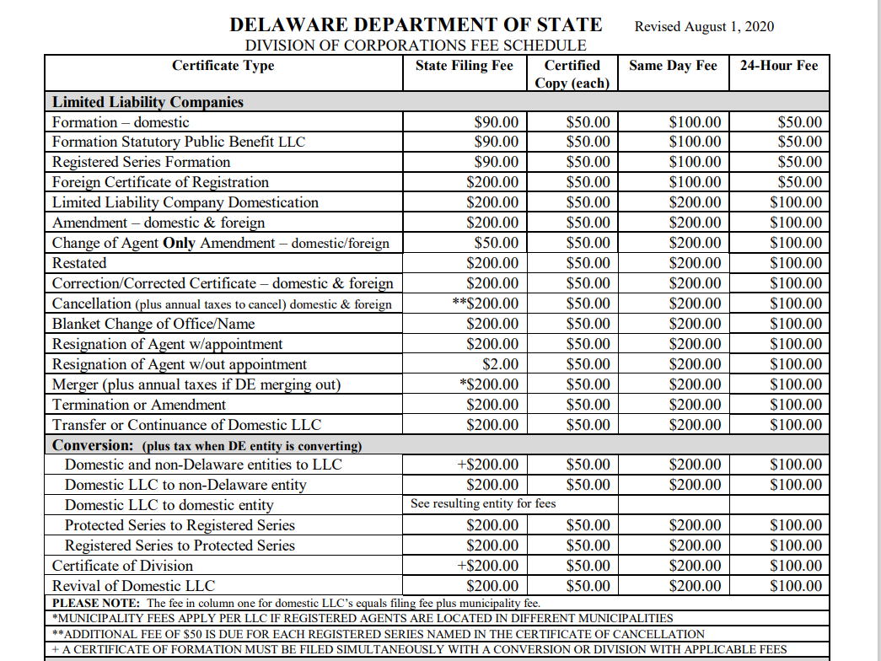
Why Would Delaware Sell shell companies?
It costs $240+ to form a Delaware LLC within a day with a certified copy that can be used to open accounts.
LLCs are also required to pay an annual tax of $300.
Total:
$540+ first year, then $300 per year, plus many more fees for amendments, termination, etc.
Delaware is making a ton of cash from business registrations:
Coindesk has reported that Delaware makes 40% of their state revenue from corporate fees.
Lawyers and registered agents are making a lot of $$$$ from shell companies:
An entire industry has grown in Delaware to support the creation of these entities. Business attorneys and others are profiting from them.

Slide 8
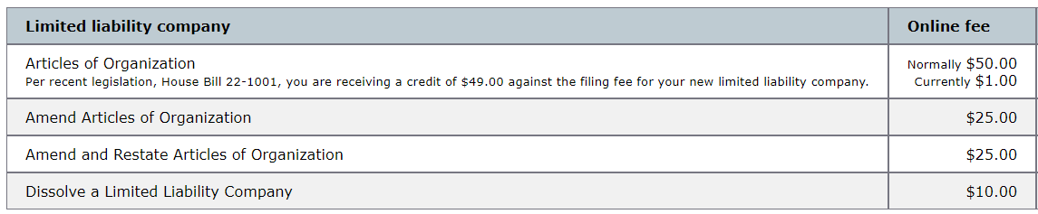
Why would Colorado want to sell shell companies?
Presently, Colorado only makes $1 from the formation of shell LLCs, only $10 annually from the filing of periodic reports, and no money for Certificates of Good Standing.
Delaware LLCs make Delaware more than $3,240 over 10 years.
Colorado LLCs make Colorado just $91 over 10 years.

Slide 9
How does Delaware incorporation Differ from Colorado other than fees?
Delaware requires Registered Agents to (by statute):
Take reasonable steps to verify the identity of the potential customers, which can include manual verification, the use of software and 3rd party services, and obtaining identity documents.
They must compare new customer information against the Office of Foreign Assets Control (OFAC) before performing services for a new customer.
They must retain full name, business address, telephone number of current communication contacts and they may obtain additional information such as information on officers, directors, and members and all of this must be compared against OFAC.
They must annually update communication contacts for their entities.
They must perform a quarterly review against OFAC and receive notifications from OFAC.
They must forward the annual tax documents to the entities.
If they manage more than 50 businesses, they must be licensed.

Slide 10
HOW CRIMINALS USE SHELLS TO VICTIMIZE PEOPLE AND BUSINESSES

Slide 11
There are two types of shell companies
Authentic Shell Companies
They are incorporated using authentic information.
They are responsive to contact.
The basis of their incorporation is lawful.
They may be used for both legal and illegal purposes.
Illicit Shell Companies
They incorporate using false information.
They are non-responsive to contact.
The basis of their incorporation is unlawful.
They are much more likely to be used to violate state and federal law.

Slide 12
Benefits of an illicit shell company
Unlike regular businesses and even authentic shell companies, they:
Likely won't get prosecuted for not paying their state sales and income taxes.
Likely won’t get prosecuted for not paying their federal income taxes.
Likely won’t get prosecuted for not paying their customs duties.
Likely won’t get prosecuted for importing dangerous and counterfeit goods into the US.
Likely won’t get prosecuted for exporting weapons and components to US enemies.
Likely won’t get prosecuted for stealing money from people donating to charities.
Likely won’t get prosecuted for stealing money from personal and business bank accounts.
Likely won’t get prosecuted for violating human rights, using child labor, and enslaving employees?
They offer incredible competitive advantages over authentic Colorado companies.

Slide 13
How Can Coloradoan small businesses survive?
How can any Colorado business compete against illicit shells that:
Don’t pay taxes,
Don’t pay customs duties
May import counterfeit goods
May use child and slave labor
…and do not care about getting caught because the owners live in a foreign country without extradition, and they can simply create a new shell for a buck here in Colorado in under 30 seconds?

Slide 14
Illicit Shells Hurt much more than just small businesses
They also hurt real people, both here in Colorado and around our nation:
Pig Slaughter Romance Fraud
Cyber extortion
Loan Fraud (PPP, EIDL, more)
Unemployment Fraud
Raising prices of homes and local goods
Destroy families and their jobs
Steal tax money from our state, other states, and the federal government
Counterfeit goods put our lives and our children's’ lives at risk.
Counterfeit medications, airplane parts, safety gear, and so much more.

Slide 15
Illicit Shells weaken America
Foreign governments that support the creation of Colorado illicit shell companies do so to weaken our country, our people, our businesses, our critical infrastructure, and our military.
Illicit shell companies can, and have, been used for illegal political fundraising and foreign influence.
Corrupt government officials, both in the US and abroad, have used illicit shells to steal, hide assets, and funnel campaign money.

Slide 16
Why can’t Law Enforcement handle illicit shells themselves?
State and Federal prosecutors won't consider prosecuting the formation of an illicit shell unless it has been found to have directly defrauded victims of hundreds of thousands of dollars, but this doesn’t happen because:
They can incorporate unlimited illicit shells in Colorado, and they know to keep the fraud in each shell lower than prosecutorial thresholds.
They are hardly ever located in Colorado, or even in the United States.
They may never be identified because the illicit shells contain no real information and certain foreign countries rarely assist with investigations.
State and federal prosecutors DO NOT prosecute the indirect harms caused by illicit shells, such as:
The destruction of small businesses because they can't complete.
Rising home and good prices.
The bolstering of bad actors here and abroad.

Slide 17
The Corporate transparency Act (CTA) won't stop illicit shells
The CTA will only require beneficial ownership information weeks after an illicit shell is formed.
Illicit shells will have already used the incorporation to open bank accounts, obtain EINs, and other required backstopping by the time the CTA notices they haven’t filed, or they have filed false information.
The CTA won’t know who to fine since the illicit shell does not provide real information.
The owners of the illicit shell will have no consequences for failure to file CTA information.
The CTA can’t inform banks, or other private entities, that a company has failed to file.
This means that the bank and brokerage accounts, and other accounts, won’t be affected.
The CTA will have no impact on illicit shells continuing to form and hurting our people and country.

Slide 18
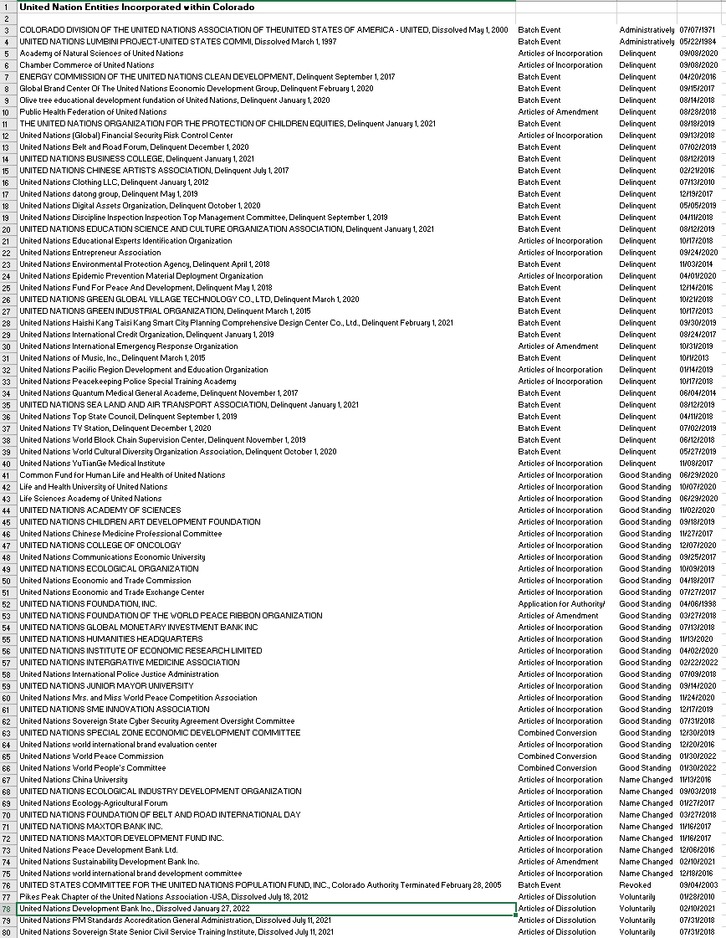
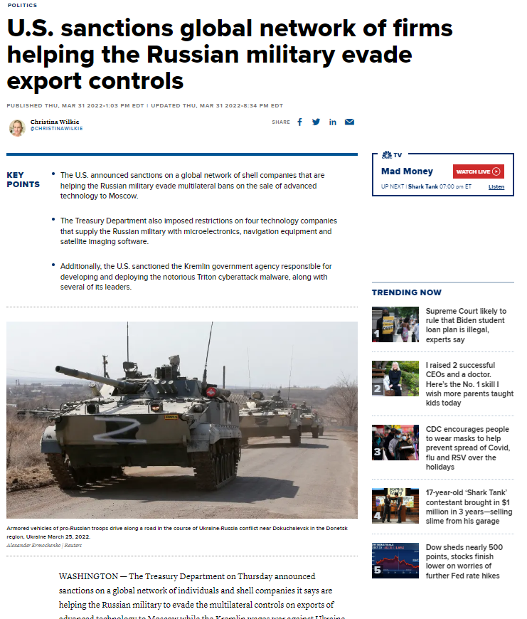
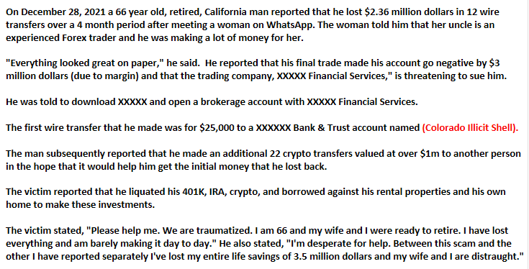
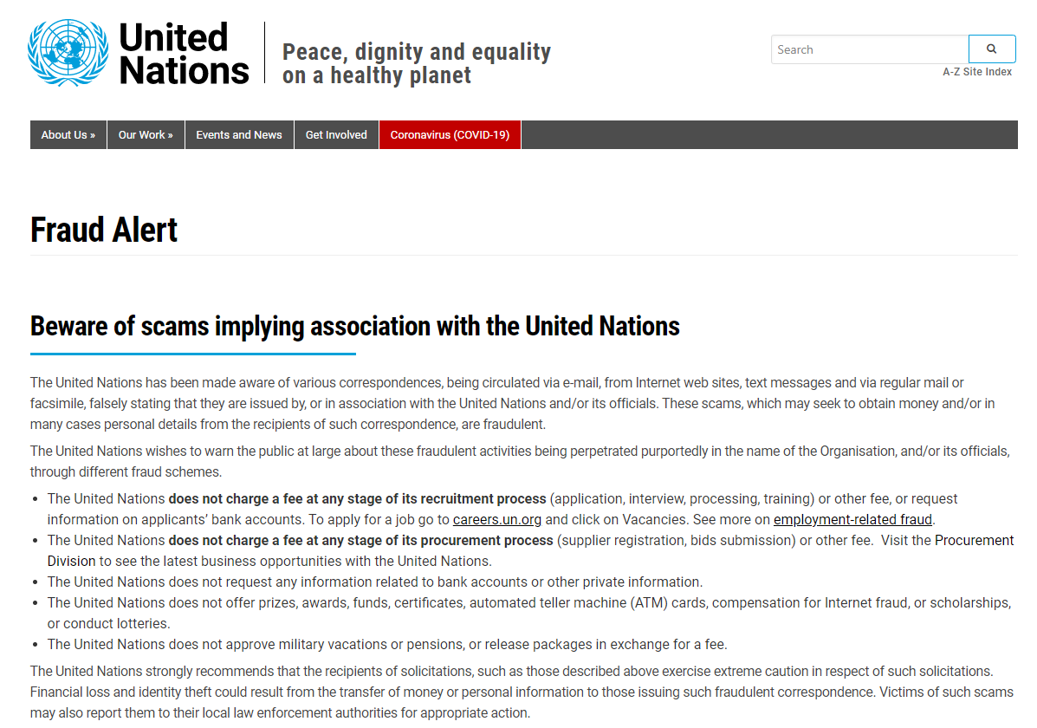
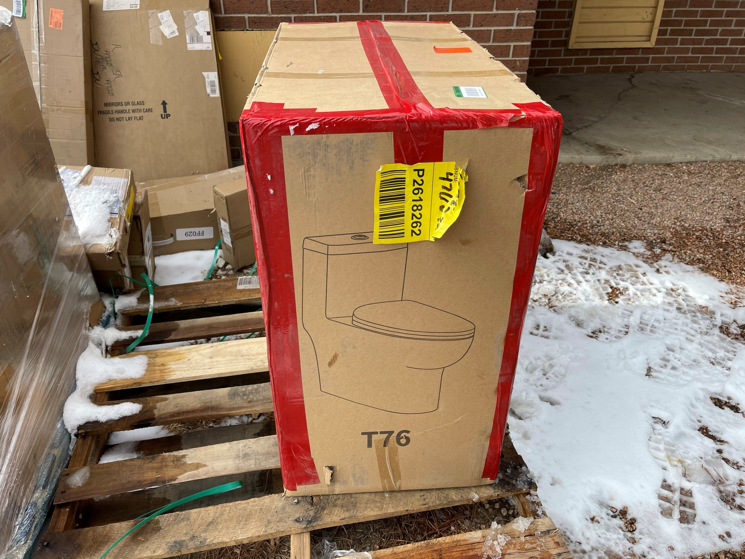
Examples
There are 80 United Nation entities registered in Colorado. Some linked to potential political corruption.
Foreign importers of counterfeit goods are using illicit Colorado shells to import hundreds of millions of dollars of counterfeit goods, and paying little to no duty, which are then sold to unsuspecting consumers.
Exporters are using illicit shells to export technology that is being used against our allies at war.
Pig Slaughter Romance Fraud

Slide 19
Our “Don’t Look Up” moment
Don’t Look Up is a movie about an astronomer that discovers a comet is on a collision course with Earth. Our planet has only 6 months to divert it before it is obliterated.
The government is briefed about the risks, and they understand the danger, but they realize that the comet, if captured instead of diverted, has tremendous commercial opportunity. They deem the opportunity to be worth more than the risk.
The capture attempt fails, and there is no stopping the comet which is on a collision course with Earth.
Knowing what is about to occur, the government tells the people: “Don’t Look Up” as the governmental leaders board a rocket to leave Earth before its obliteration.

Slide 20
If we “look up” we see…
Colorado based illicit shell companies do nothing to help Colorado businesses, our families, or our government.
Just one illicit shell can do immense harm both directly and indirectly, in the same way just one arsonist can do immense harm.
Direct Effect: An arsonist can destroy a home and kill its occupants.
Indirect Effect: That arsonist can also cause lifelong disruptions for the family members and friends that lost loved ones in the fire.
Illicit shells have had the exact same devastating effects as arsonists do to countless families and their businesses.
In Colorado we can identify arsonists, we prosecute arsonists, and we don’t want even one arsonist to be on the loose in our state. We need to start seeing illicit shells for what they really are – they are created to victimize. They are created to steal. They are created to hide in the shadows. They are created to burn America to the ground.

Slide 21
12 Proposals

